Slide 1
STAT854 Presentation Mirror-Match Bootstrap(BMM)
Huaijin Li, Yuqi Jing, Yuxin Xiao
Notes:
In this video, the topic we would like to talk about is called Mirror-Match Bootstrap.

Slide 2
Agenda
1. Introduction
2. Application of bootstrap weights in SAS
3. Essential R code
4. Application of the bootstrap weights to the Survey of Youth in Custody (SYC)
5. Result Comparison and Analysis
Notes:
I will cover the first two sections to give a brief introduction to this algorithm and the application of bootstrap weights in SAS. Then Yuqi will introduce the critical R functions to compute the bootstrap weights and Huaijin will talk about how to perform analysis on the Survey of Youth in Custody (SYC) using the bootstrap weights computed in R and compare the results obtained using Taylor expansion.

Slide 3
1. Introduction: Why Mirror-Match Bootstrap?
Unbiased estimates for variance of statistics of interest can be derived only if it can be expressed as a linear combination of observations
Statistics that are not linear such as ratio estimators, require different methods for variance estimation
Taylor Expansion has its limitation of derivation for the expression of nonlinear estimators and computing the derivatives, which could be complicated to apply
Replication methods have the advantage of being simple to implement due to the advance in computational power, but standard bootstrap results in biased variance estimation with unrealistic with-replacement resampling scheme
Mirror-match method has the advantage of without-replacement resampling to mirror the original sampling scheme
Using the mirror-match procedure, the variance estimate is unbiased for linear estimators and is consistent for nonlinear estimators. This procedure can also be applied to more complex survey designs
Notes:
So why we are interested in this specific bootstrap method. When calculating the population parameter of interest, in addition to the point estimate we typically also want to estimate its variance. Recall that when the estimator is a linear combination of observations, we can derive the unbiased estimator of its variance.
However, the derivation can become complicated when we have nonlinear statistics such as ratio estimators. Of course we can approximate this nonlinear statistic in a linear form by Taylor expansion, but calculating the derivative can be very difficult. Therefore, replication methods become an attractive solution since they are simple to compute.
One of these replication methods is called Bootstrap, but the standard Bootstrap typically performs sample with replacement which is unrealistic most of the time and the variance estimate can be biased. Therefore, a variant of Bootstrap called the mirror match method is proposed.
It has the advantage of without-replacement resampling to mirror the original sampling scheme, and the with-replacement between bootstrap reserves the sampling distribution of responses.
Moreover, for linear statisitcs, the variance estimator is unbiased and is consistent when the estimator is nonlinear. Another advantage is that It can be applied to more complex survey designs.

Slide 4
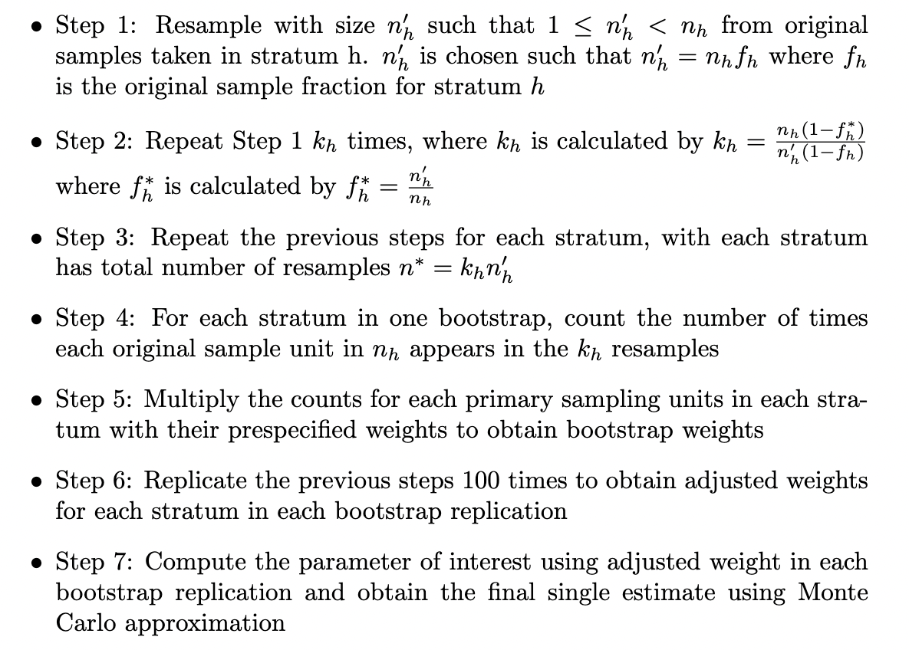
1. Introduction: Mirror-Match Procedures
Notes:
Now let’s move on to the steps we take to find bootstrap weight using this algorithm.
We first select a subsample without replacement with size n’h from nh to mirror the original sampling scheme We repeat this with a specified number of times called kh. We repeat the previous two steps for each stratum and count the number of times that each original sampling unit appears in all the kh resamples.
To get the bootstrap weight, we multiply the counts for each sample with their prespecified weight in the dataset. We replicate the previous steps for 100 times to obtain the adjusted weights for each stratum that are ready to be used in SAS.
Finally, we compute the estimator of interest using computed bootstrap weights and obtain the final variance estimate using the Monte Carlo approximation

Slide 5
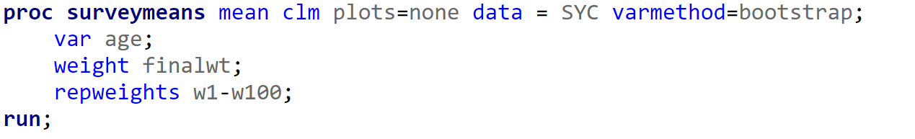
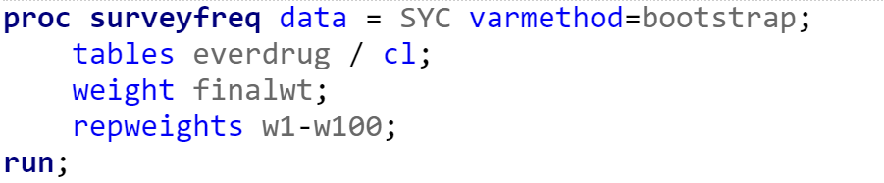
2. Application of bootstrap weights in SAS
1. First, we merge the matrix of bootstrap weights on the SYC dataframe
2.
Notes:
The final step leads us to the second section of this presentation. After we obtain the dataset of bootstrap weights in R, we merge this with the survey data and import it in SAS. What’s different from before when using proc surveymeans and proc frequency is that we need to specify varmethod equal to bootstrap in the statement.
Moreover, we need to provide two weights, the first of which is the one stored in the dataset. It is used to calculate the point estimate from the full sample. the second weight is the repweights, for which we provide the bootstrap weights stored in variable w1-w100 to find the point estimate for each time of bootstrap

Slide 6
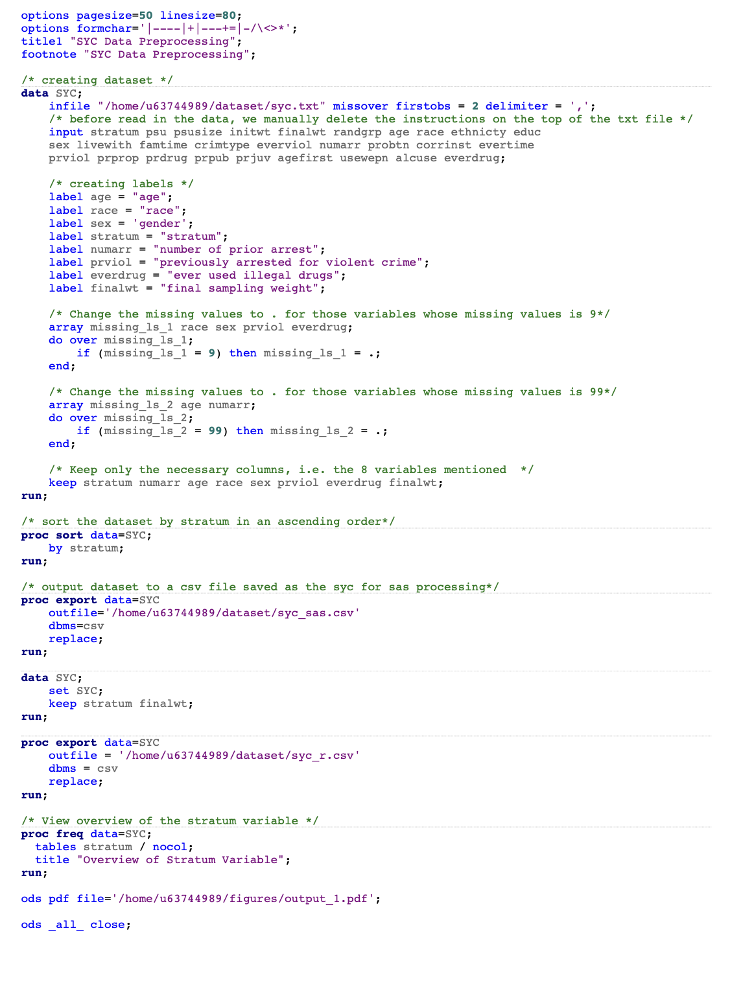
3. Essential R code: Data Preprocess using SAS
Handle missing values in the dataset by setting missing values as ‘.’
Keep only the necessary columns, i.e. the 8 variables mentioned in A2Q4
Groupby the dataset by stratum in an ascending order
Export a syc dataset called syc_sas.csv with 8 variables for calculation in SAS
Export another syc dataset call syc_r.csv with 2 variables (stratum, finalwt) for computing bootstrap weight in R
Notes:
It's worth mentioning that the unit order inside each stratum remains unchanged.
Point estimate and variance estimate
bootstrap weights

Slide 7
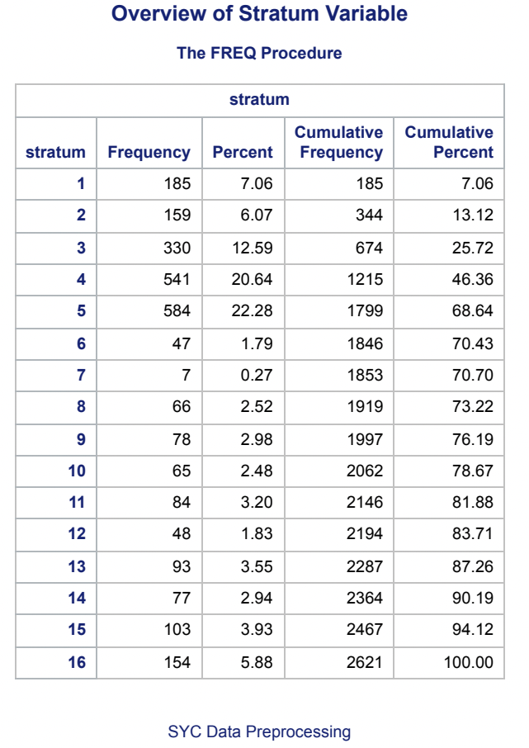
3. Essential R code: Data Preprocess using SAS
In addition, PROC FREQ is used to generate frequency counts for the stratum variable

Slide 8
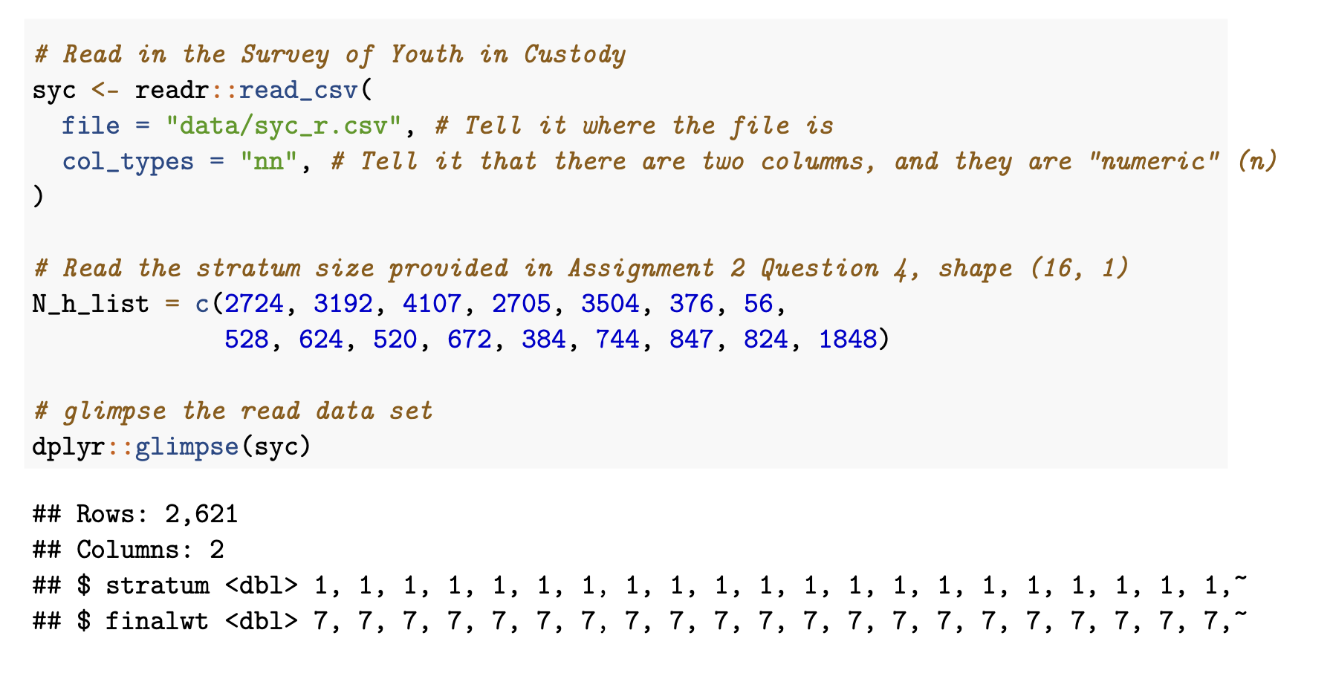
3. Essential R code: Reading in Dataset
We read in the syc_r in R and log the Nh information provided in A2Q4

Slide 9
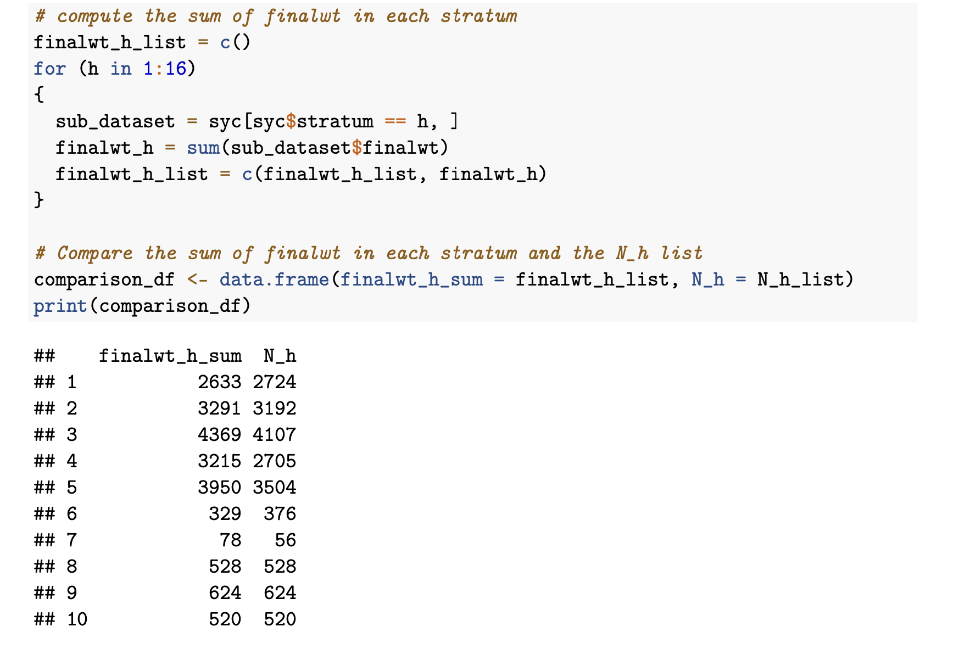
3. Essential R code: Finalwt Rescaling
We found that the sum of finalwt in each stratum is different from Nh
This can potentially dampen the estimation result

Slide 10
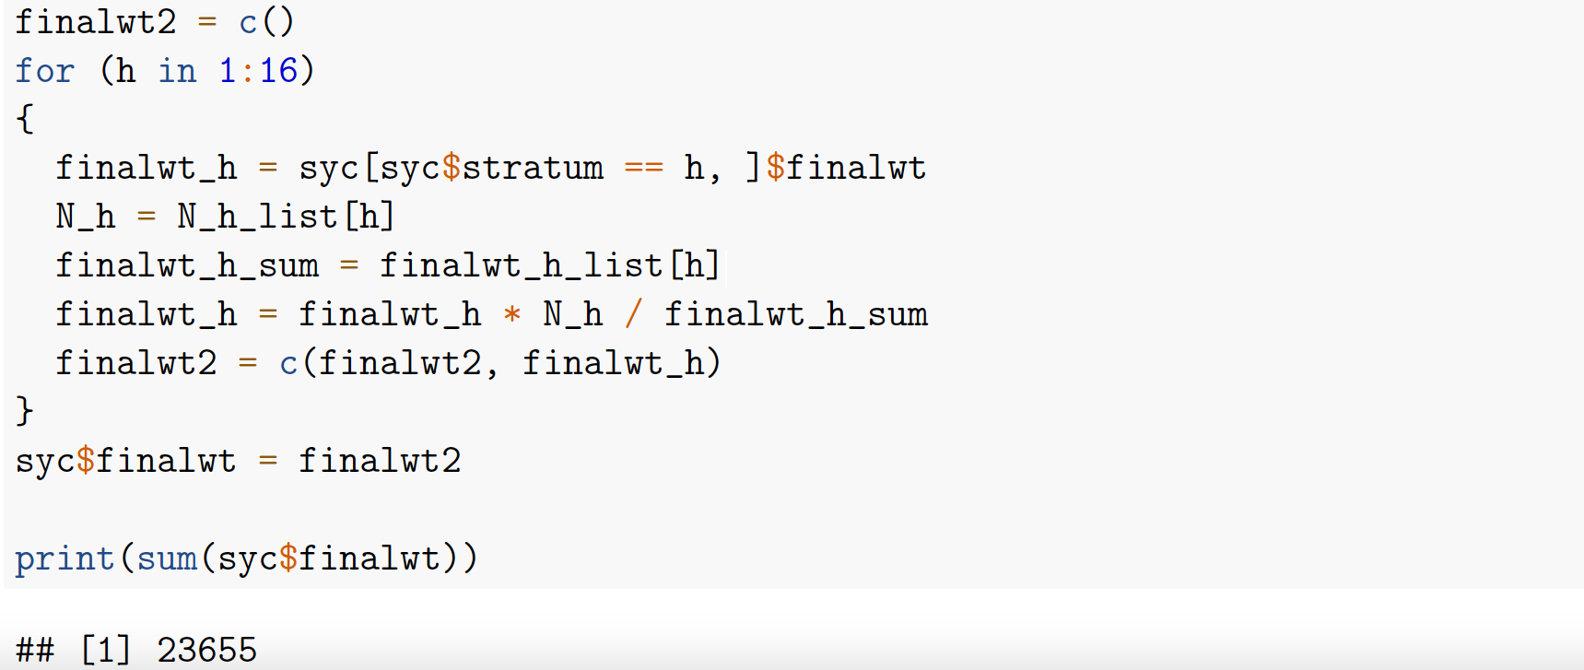
3. Essential R code: Finalwt Rescaling
Rescale the weight stored in the variable finalwt so that the sum equal to population size in each stratum
Sincerely thank Professor Boudreau for providing us with the code

Slide 11
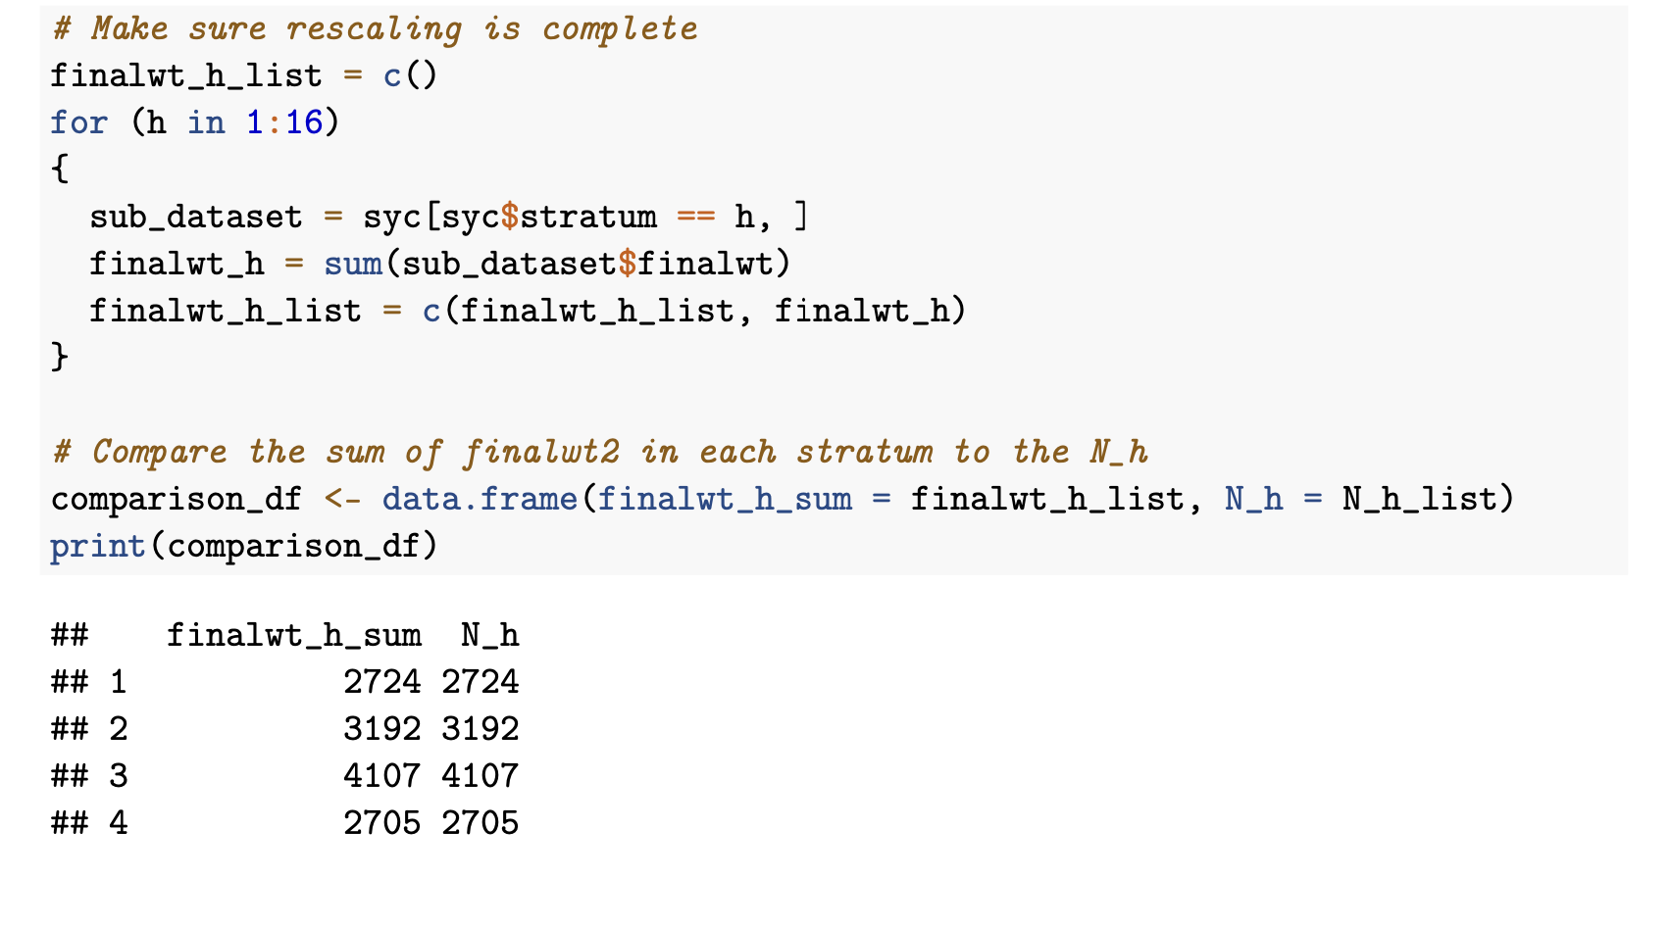
3. Essential R code: Finalwt Rescaling

Slide 12
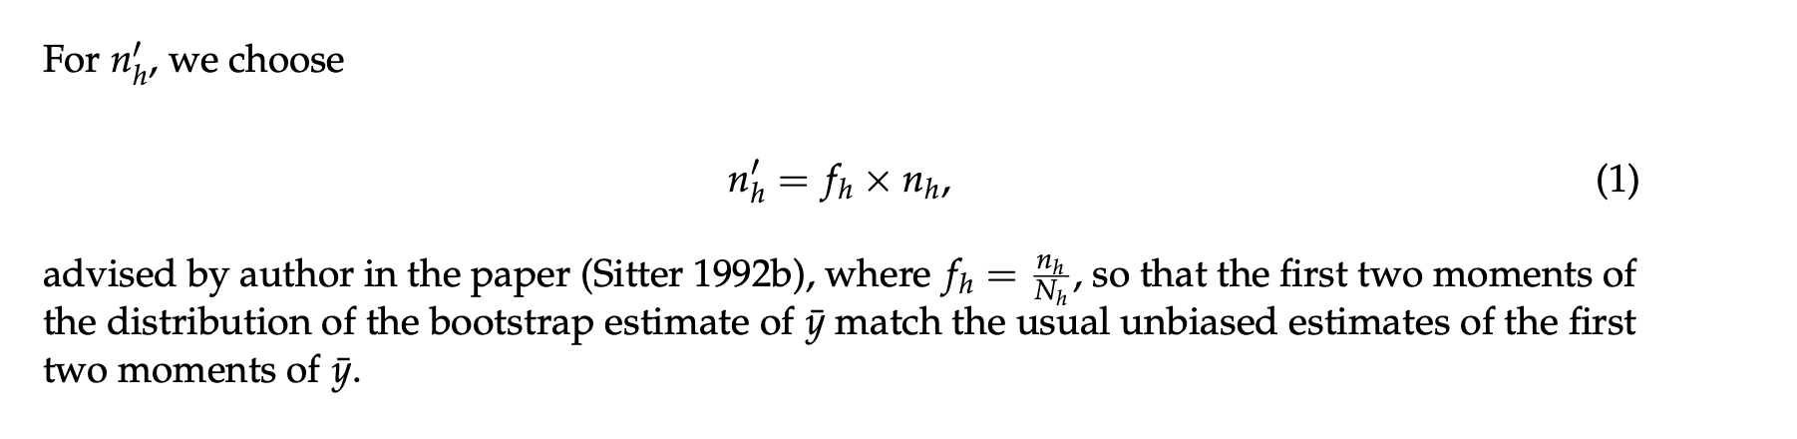
3. Essential R code: mirror-match bootstrap for stratum h
Mirror-match bootstrap for stratum h

Slide 13
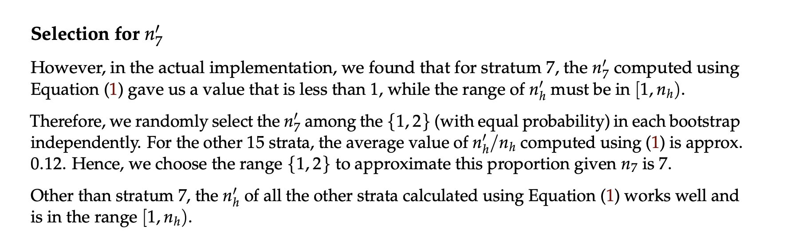
3. Essential R code: mirror-match bootstrap for stratum h
Mirror-match bootstrap for stratum h

Slide 14
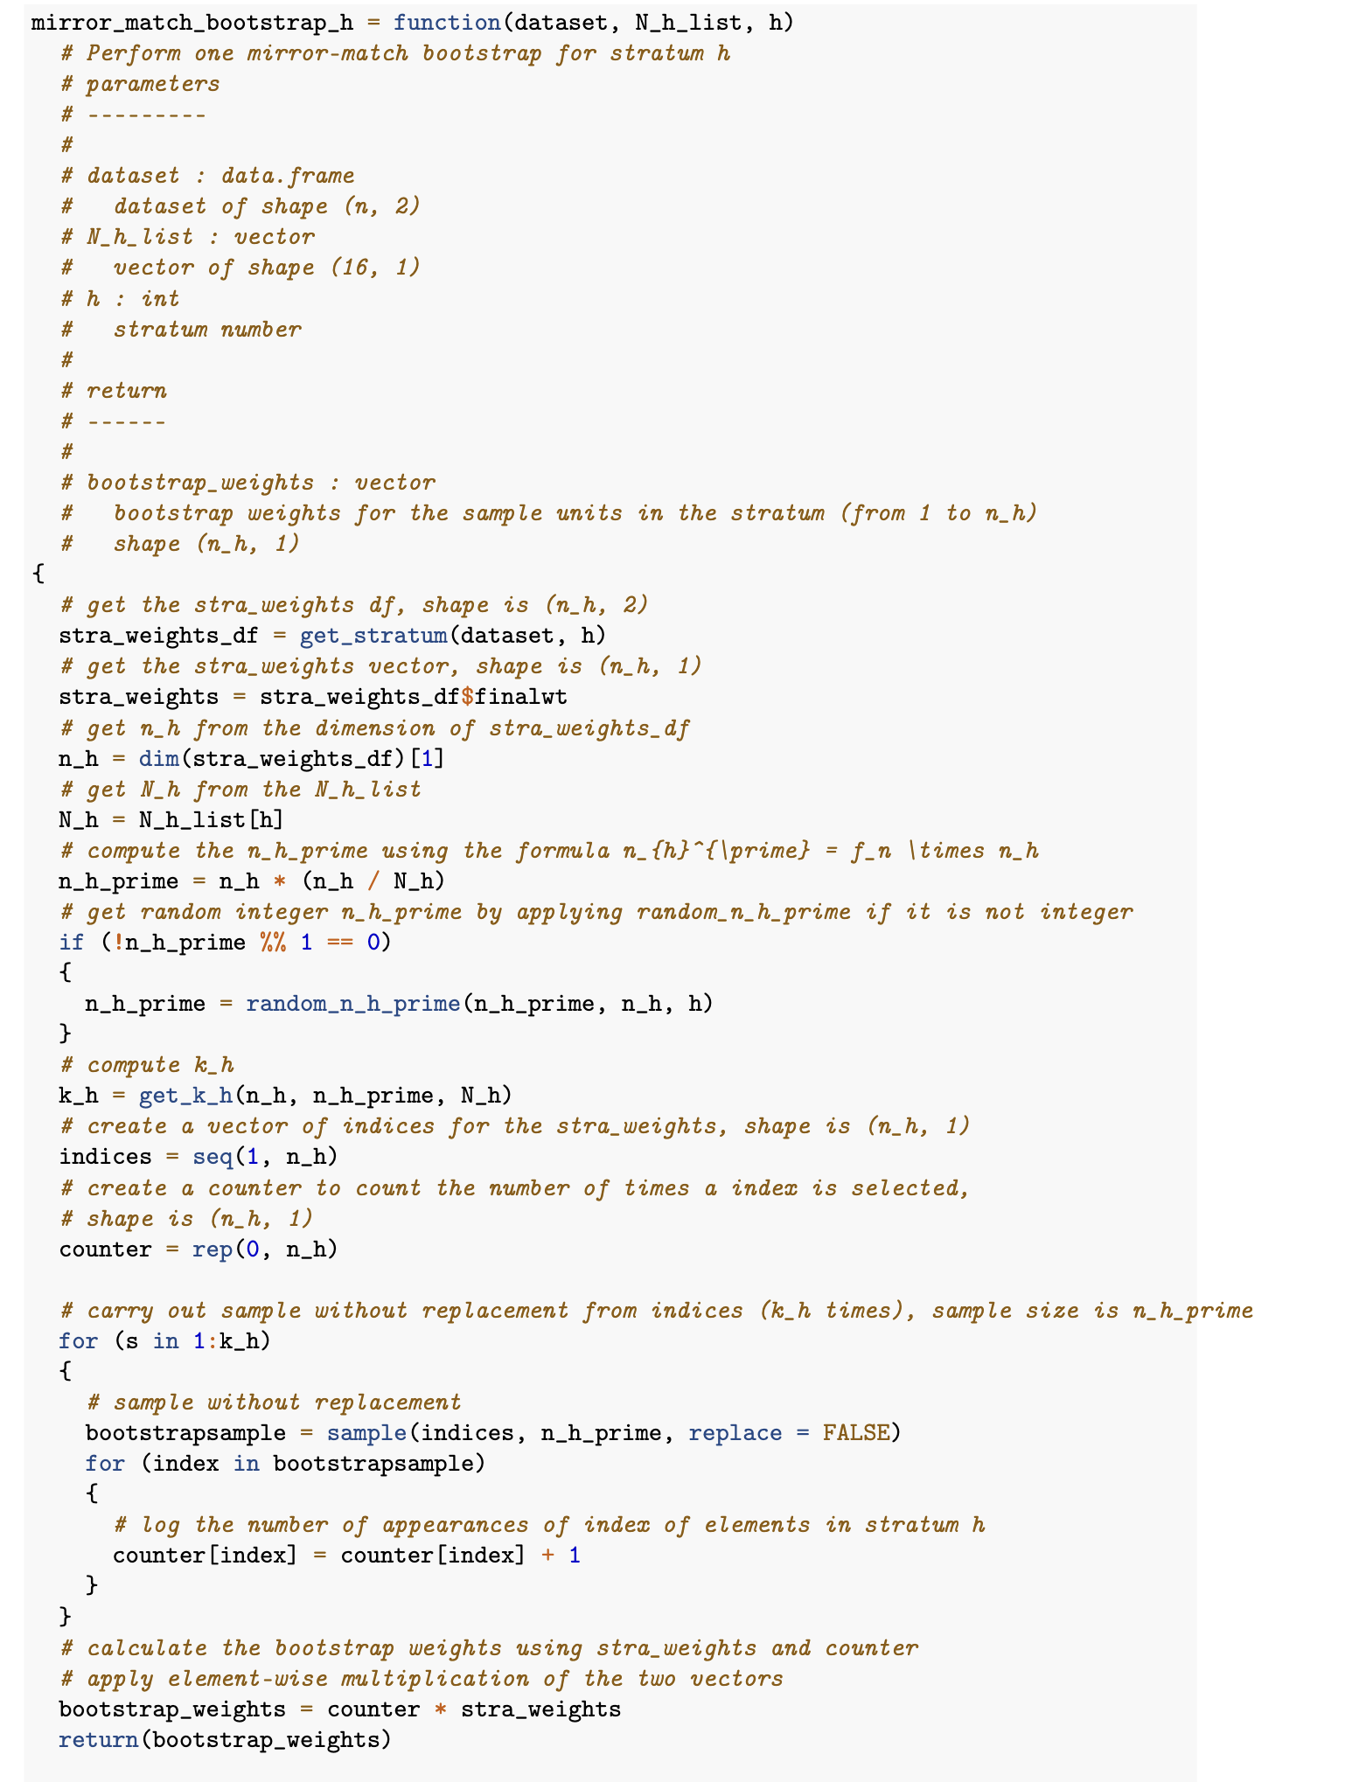
3. Essential R code: mirror-match bootstrap for stratum h
Mirror-match bootstrap for stratum h
Notes:
We first obtain the n_prime and k for the stratum h.
Then we carry out sample without replacement k times with sample n_prime, each time we replace the sample.
Afterwards, we multiply the counter of stratum sample with the finalwt in an elementwise fashion to derive the bootstrap weight.

Slide 15
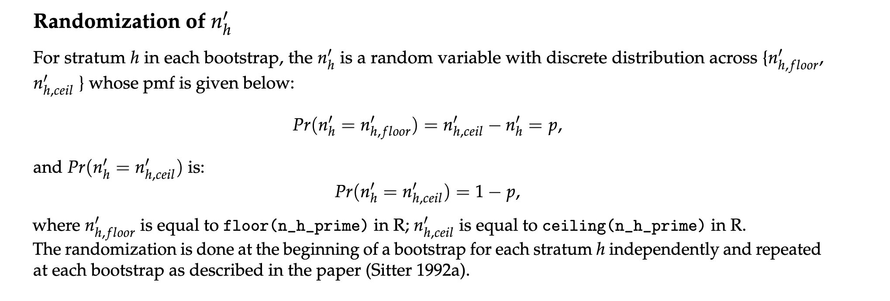
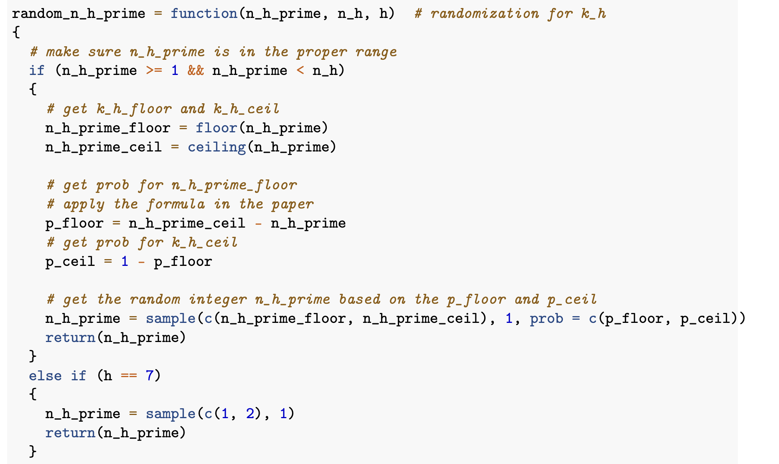
3. Essential R code: mirror-match bootstrap for stratum h
Mirror-match bootstrap for stratum h
Notes:
largest integer smaller than n_prime
smallest integer larger than n_prime
After we ...
most likely we ...
therefore ... randomize
based on the closeness of

Slide 16
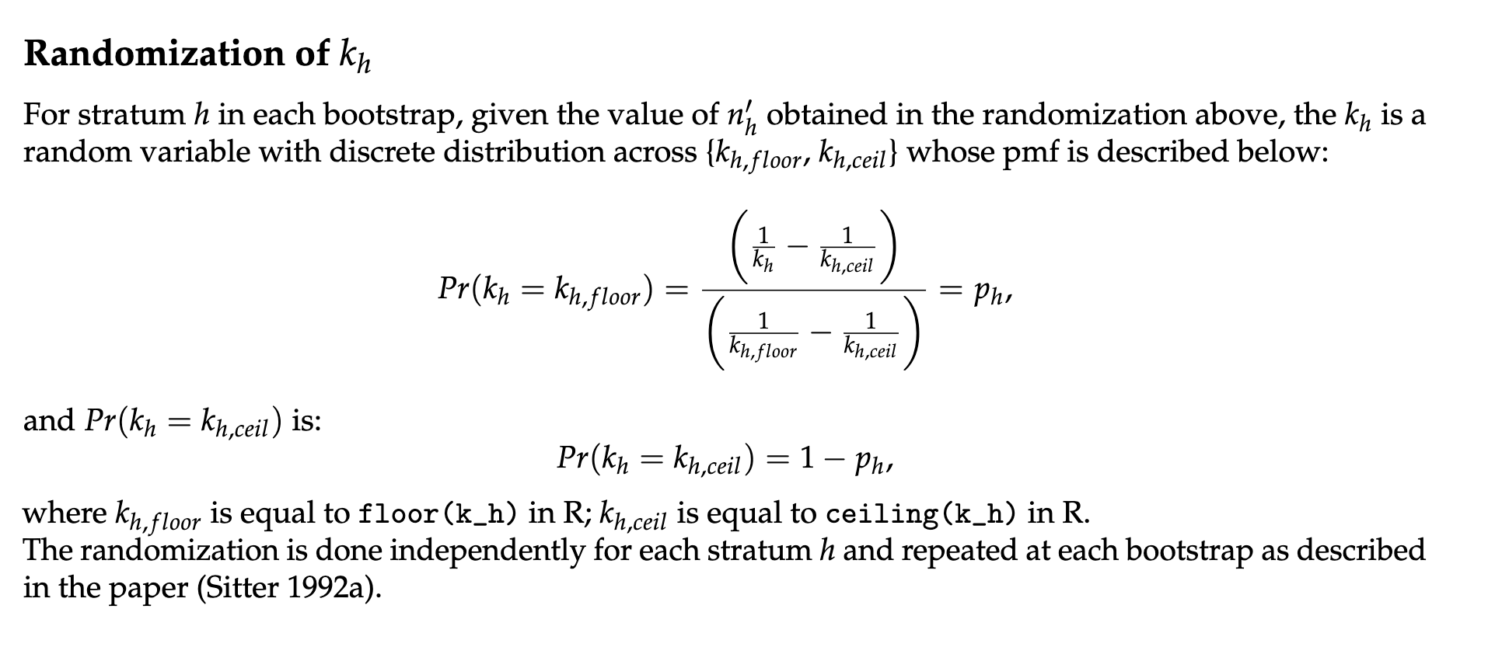
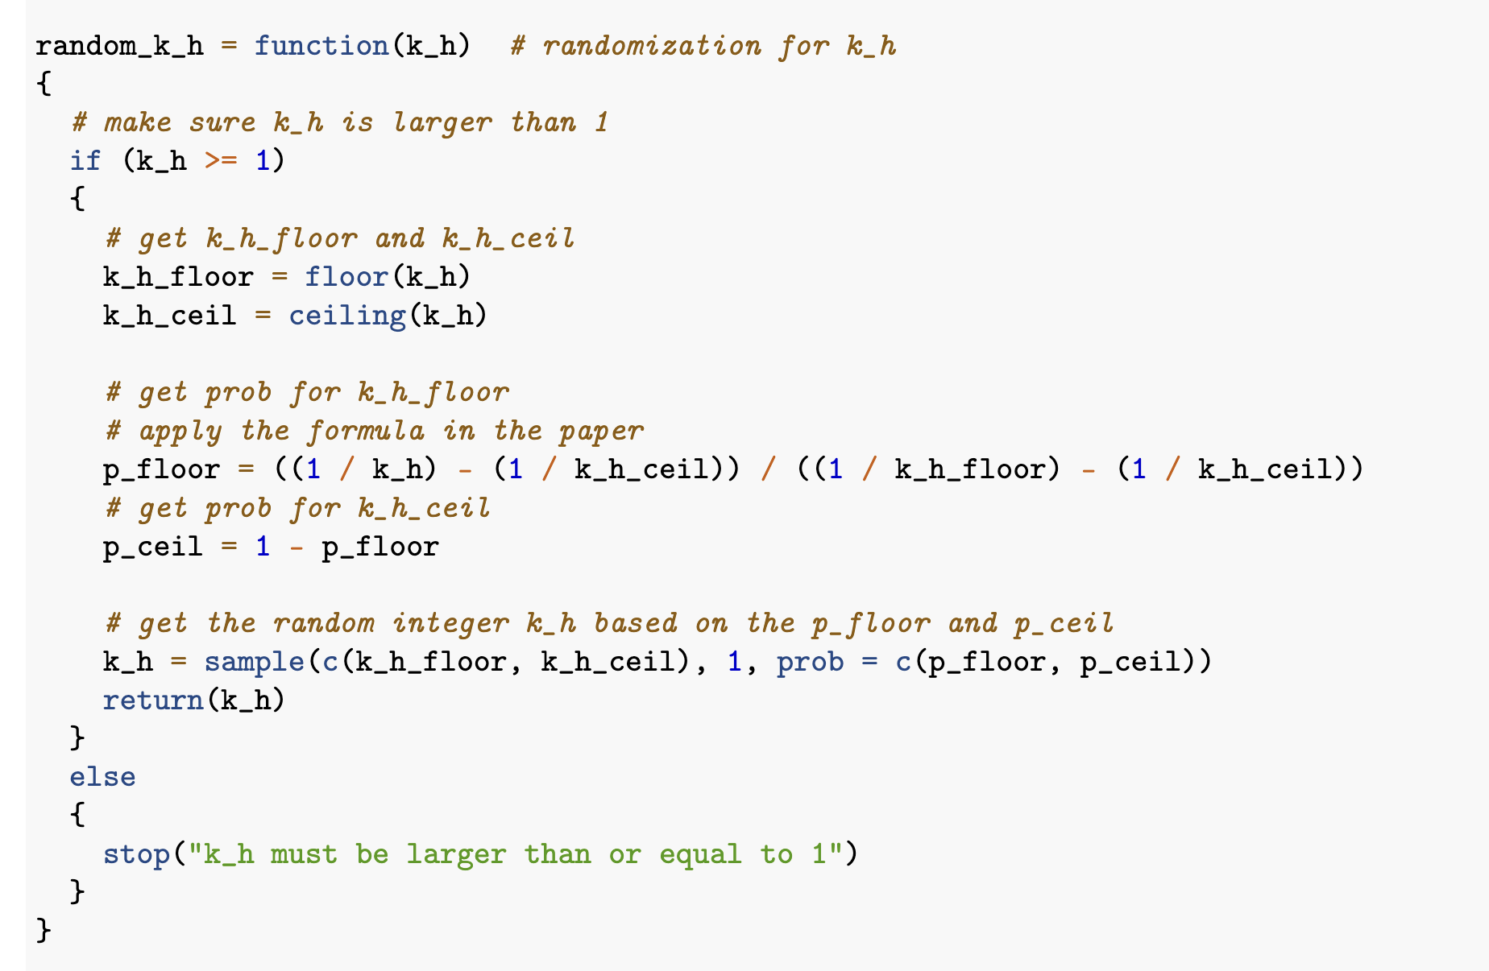
3. Essential R code: mirror-match bootstrap for stratum h
Mirror-match bootstrap for stratum h

Slide 17
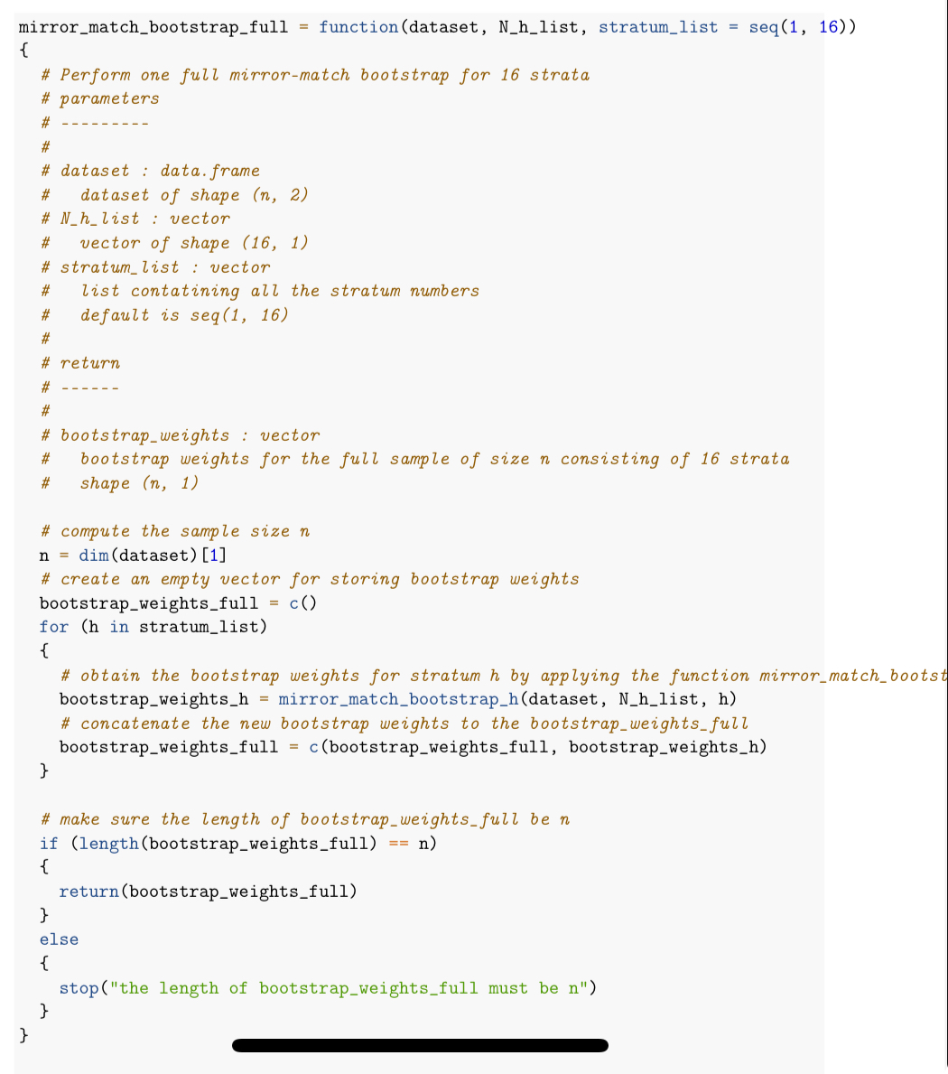
3. Essential R code: one complete bootstrap for the sample of size n
Perform bootstrap for all the 16 strata in the sample
Return a vector of weights of length n

Slide 18
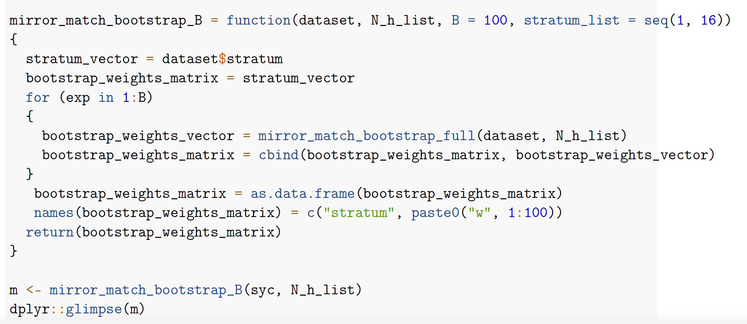
3. Essential R code: Repeating the full bootstrap B times
Obtain the bootstrap weight matrix by repeating the full bootstrap B times.
Bootstrap weight matrix has shape (n, B).

Slide 19
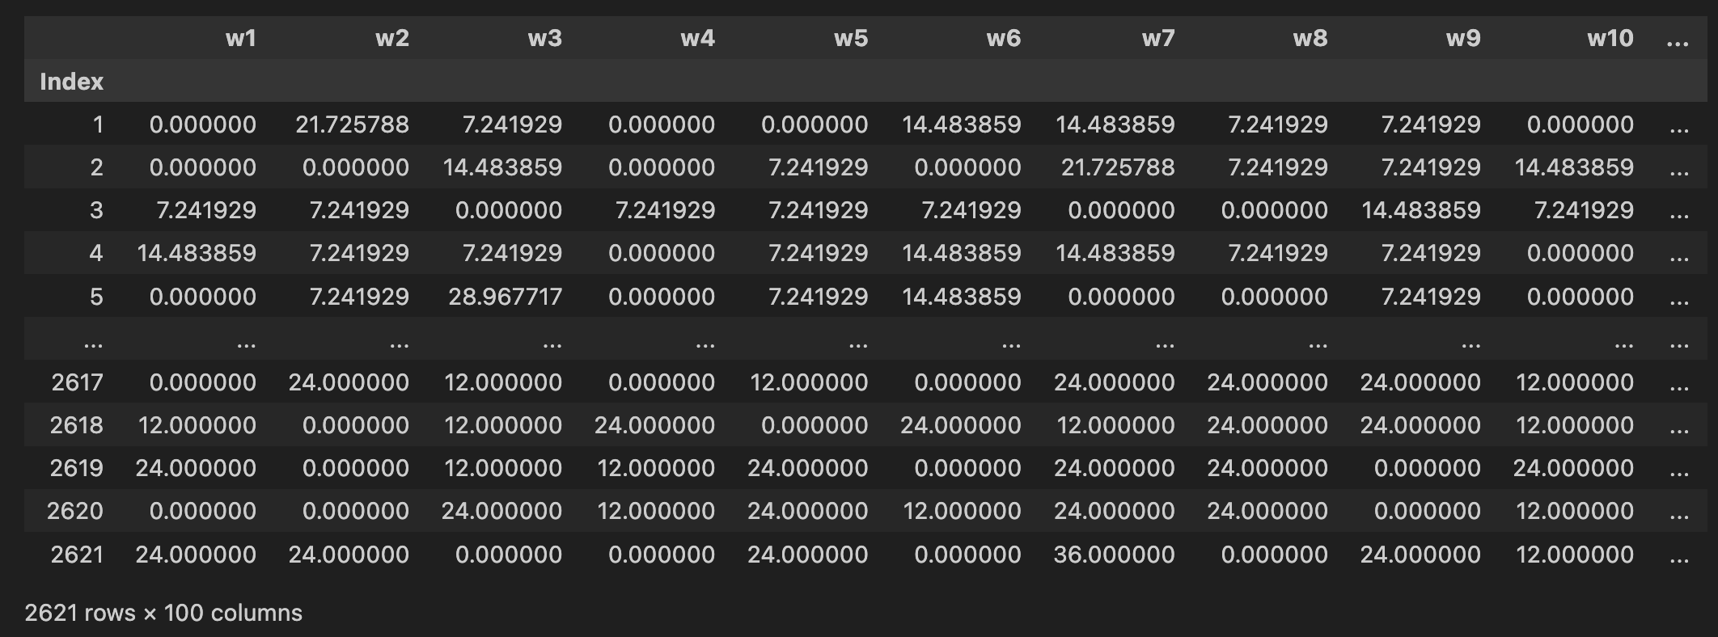
3. Essential R code: Repeating the full bootstrap B times
We get a glimpse of the bootstrap weight matrix (2621 by 100).

Slide 20
4. Application of the bootstrap weights to the Survey of Youth in Custody (SYC)
Step 1: First we determine the population size and sample size for each stratum.
Step 2: Next, we compute the value of scaled finalwt, which will subsequently be multiplied by bootstrap counts to derive bootstrap weights in step 5.
Step 3: We then assess the properties of each stratum to determine whether a random n' or a calculated n' should be utilized.
Step 4: Following the calculations in Step 2, it is determined that only the stratum 7 needs a random n' selected from {1, 2}. The n' for other strata will be calculated as outlined in section 1.
Step 5: Finally, we employ the mirror_match_bootstrap_B method to generate the bootstrap weights for the SYC data.

Slide 21
5. Result Comparison
Category | Point Estimate | Bootstrap Std Error | Bootstrap CI | Taylor Std Error | Taylor CI
Average age of people | 16.6720 | 0.0323 | [16.6078, 16.7361] | 0.0334 | [16.6054, 16.7375]
Mean number of prior arrests | 8.9172 | 0.2453 | [8.4306, 9.4039] | 0.2621 | [8.4032, 9.4312]
Proportion of people that have used illegal drugs | 82.8991% | 0.8678 | [81.1774, 84.6209] | 0.8876 | [81.1587, 84.6396]
Proportion of people that were previously arrested | 35.6784% | 1.0053 | [33.6839, 37.6728] | 1.0751 | [33.5703, 37.7864]

Slide 22
5. Result Comparison
Category | Point Estimate | Bootstrap Std Error | Bootstrap CI | Taylor Std Error | Taylor CI
Proportion of people that have used illegal drugs and were previously arrested | 31.6782% | 0.9769 | [29.7401, 33.6164] | 1.0363 | [29.6461, 33.7104]
Proportion of males in custody | 93.1752% | 0.5600 | [92.0642, 94.2862] | 0.5392 | [92.1180, 94.2324]
Proportion of African Americans in custody | 41.4124% | 1.1061 | [39.2178, 43.6070] | 1.1266 | [39.2032, 43.6216]
Proportion of African Americans males in custody | 39.6788% | 1.0983 | [37.4998, 41.8577] | 1.1189 | [37.4847, 41.8729]

Slide 23
5. Result Analysis
The variances obtained through bootstrap weights are very close to those from Taylor expansion, showing an evidence that Mirror Match bootstrap can fix the biased variance estimator.
For most of parts, the results obtained through bootstrap weights exhibit less variances and tighter confidence intervals comparing to those from Taylor expansion

Slide 24
References
Sitter, Randy Rudolf. 1992a. “A Resampling Procedure for Complex Survey Data.” Journal of the American Statistical Association 87 (419): 755–65.
Sitter, 1992b. “Comparing Three Bootstrap Methods for Survey Data.” Canadian Journal of Statistics 20 (2): 135–54.

Slide 25
THANK YOU

